Slide 1
POCO C++ lib
조욱래
2012-1221

Slide 2
글의 목적.
다양한 서버 설정 파일을 비교 분석하여 향후 제작되는 서버들의 설정파일 결정에 참고가 되도록 한다.
주요 비교 대상은 다음과 같다.
YAML
XML
INI
POCO-PROPERTY

Slide 3
목차
YAML 소개
XML 소개
INI 소개
POCO-PROPERTY소개.
각 방법의 장단점 비교분석.

Slide 4
YAML
yaml-cpp
http://code.google.com/p/yaml-cpp/

Slide 6
POCO Conguration Files
POCO C++ LIBRARY의 설정 관련 기능분석.
http://pocoproject.org/

Slide 7
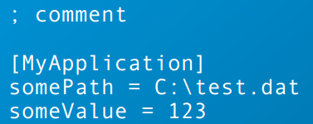
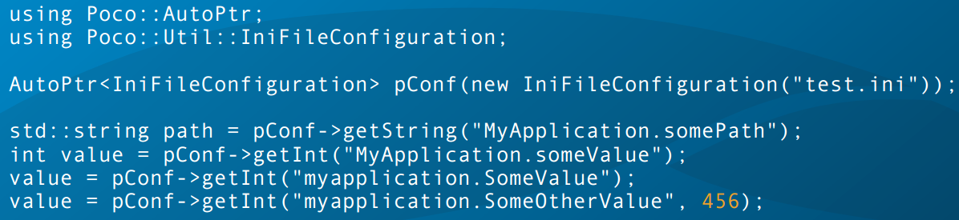
INI Files
Key names are not case sensitive.
Leading and trailing whitespace is removed from both keys and values.
read-only

Slide 8
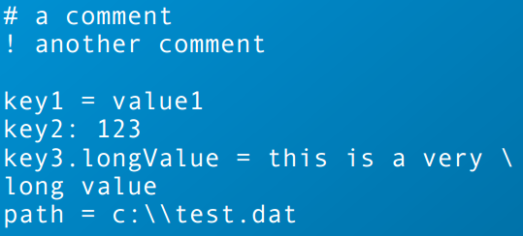
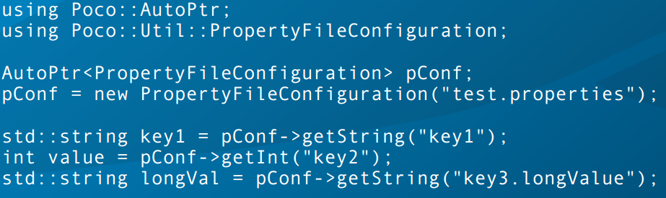
Property Files
Property Files are known mainly from Java.
Key names are case sensitive.
The backslash is used for escaping, so be careful when specifying Windows path names.
Writable
.

Slide 9
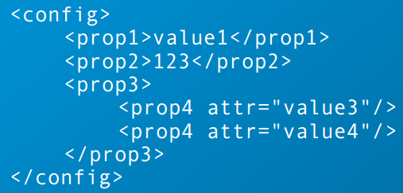
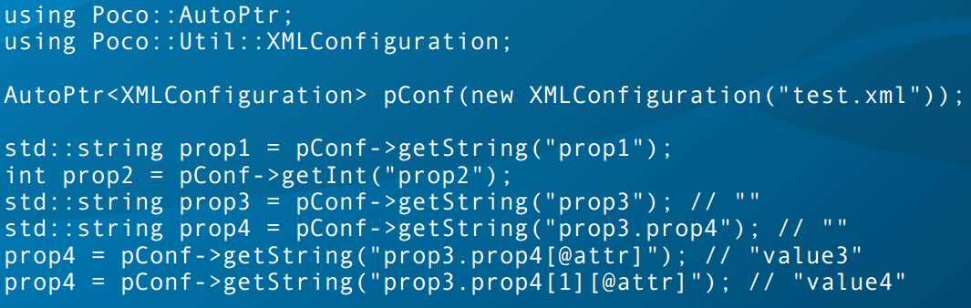
XML Configuration
XML conﬁguration ﬁles are parsed with the DOM parser and thus fully loaded into memory.
Both text in elements, as well as attribute values can be accessed, using a XPath-like syntax.
writable (fully writable since 1.3.4)
.

Slide 10
그외 설정 방법.
FilesystemConﬁguration:
a separate ﬁle for each conﬁguration property, stored in a directory hierarchy.
LayeredConﬁguration:
allows layering of multiple conﬁgurations
MapConﬁguration:
stored in a std::map<std::string, std::string>
SystemConﬁguration:
system.osName, system.osVersion, system.currentDir, etc.
WinRegistryConﬁguration (Windows only)

Slide 11
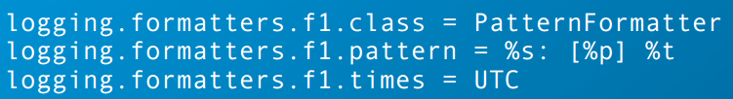
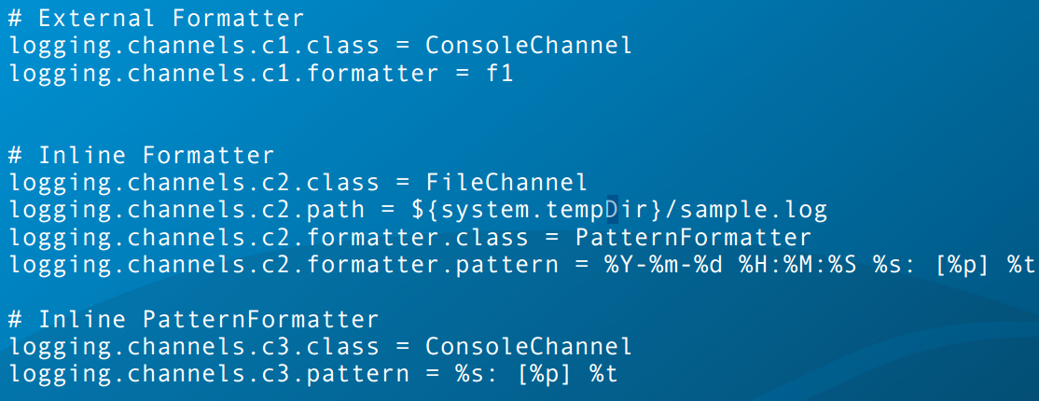
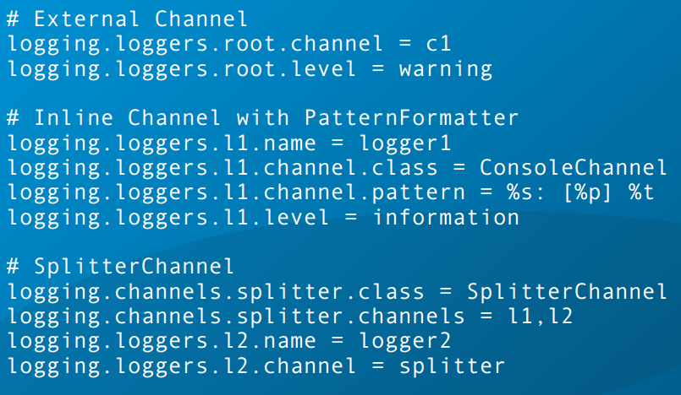
The LoggingConfigurator Class

Slide 12
Applications

Slide 13
Network Programming

Slide 14
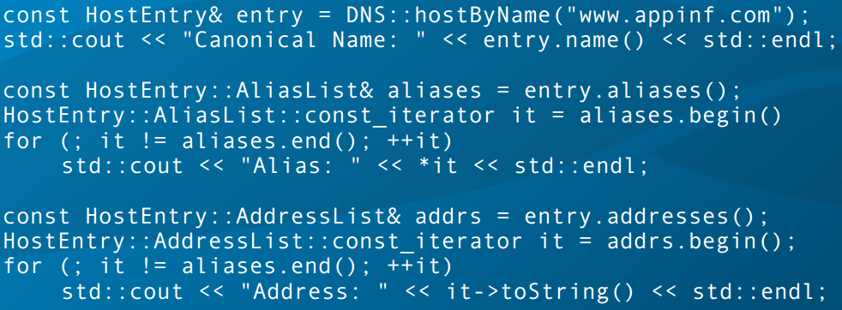
Name Resolution

Slide 15
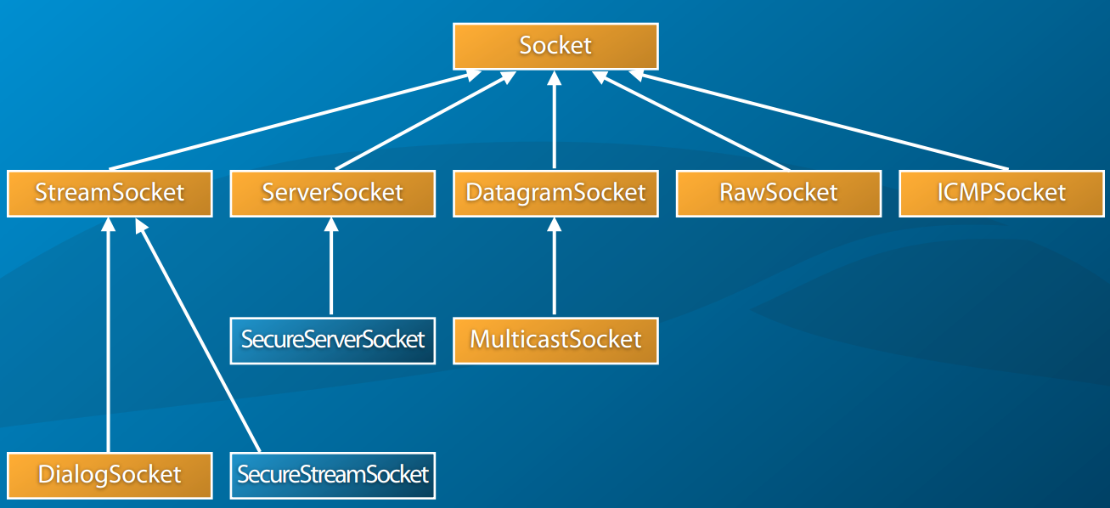
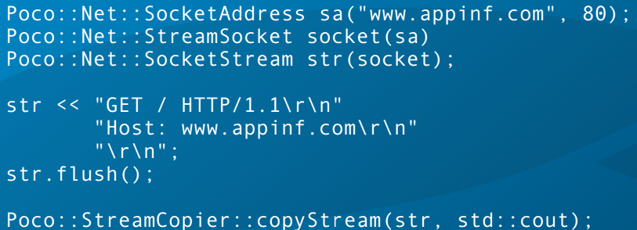
The Socket Class

Slide 16
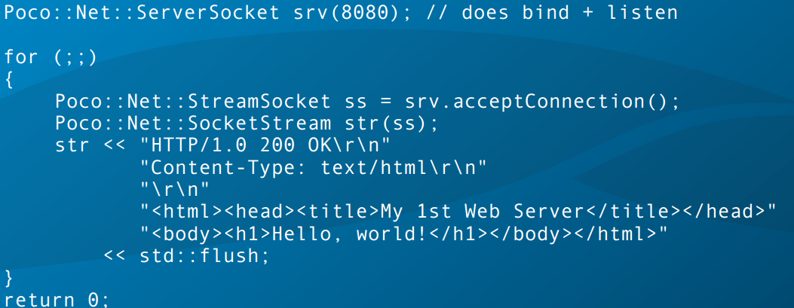
ServerSocket Class

Slide 17
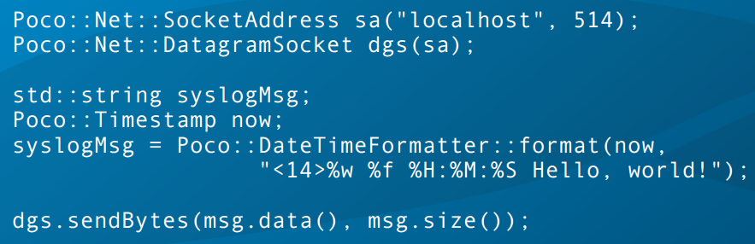
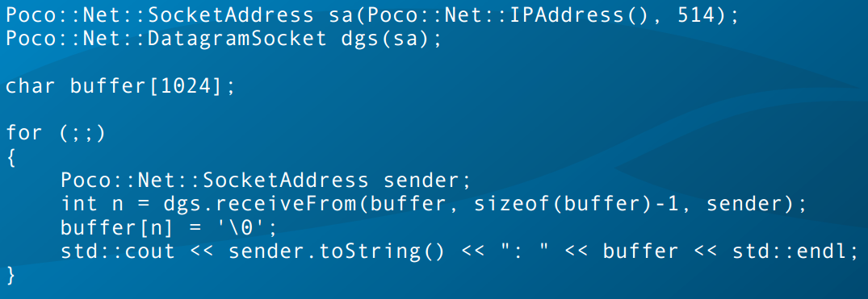
UDP Sockets

Slide 18
TCPServer Framework

Slide 19
Reactor Framework

